Slide 1


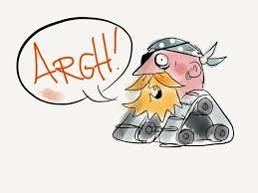
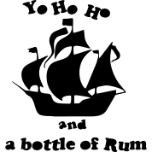
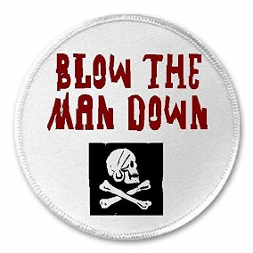
Elect to move first or swap your card with another player.
Due to the “fortification” ignore the first wound suffered this turn
Add plus one to any one combat roll this turn
Add +1 to hit for all shooting this turn

Slide 2
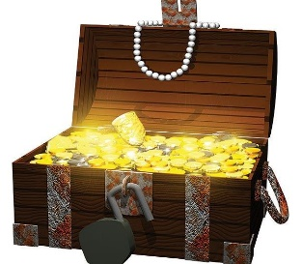


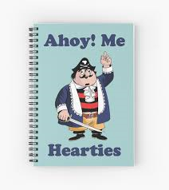
Prohibits one pirate faction from shooting or fighting with you this turn
Gain one treasure coin
One figure can automatically reload after shooting this turn
Roll 3 dice and choose the two highest when moving

Slide 3
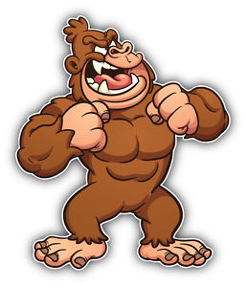
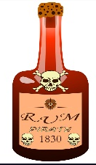
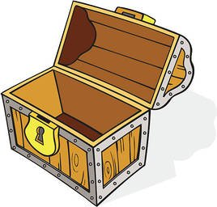
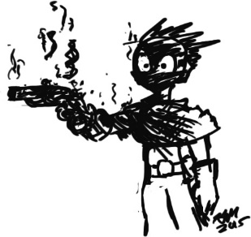
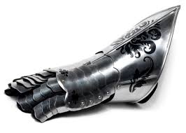
Stop monkeying
Place a gorilla figure on the table at least D6 from any figure. In future turns the player with the Jolly Roger card can move them. They move and fight as a pirate armed with an axe with an additional +1.
Yo Ho Ho and a Bottle of Rum
This card is played on any non- leader figure who promptly falls down drunk and cannot be moved unless a 6 is thrown.
Aaargh
May be played on any pirate who is about to shoot. The gun misfires or jams for that move only.
Rule of Iron
This card can be used to re-roll one dice or to cancel the “Pirate Havoc” card.
Empty Chest
This is played on one player who loses one of gold coin (if they have any) .

